Slide 1

Event Management System
Department of Computer Science and Engineering
Seshadri Rao Gudlavalleru Engineering College, Gudlavalleru
By
P.Pravallika (21481A05G0)
S.Pallavi (21481A05J8)
P.Chaitanya (21481A05F7)
P.Likshmitha (21481A05G5)
Under the guidance of
Ms. A. Ramya, M.Tech
Assistant Professor, Department of CSE

Slide 2
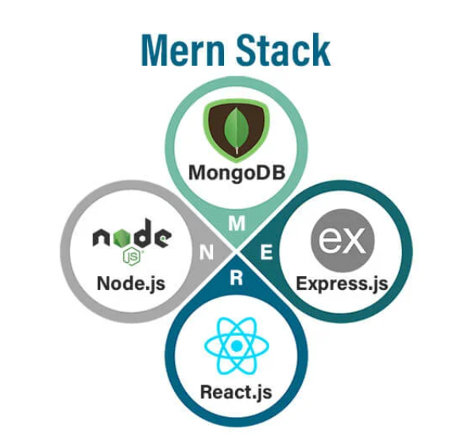
Outline
Abstract
Introduction
Requirements
Methodology
Implementation
Results
Conclusion

Slide 3
Abstract
The Event Management System is an innovative MERN stack-based platform designed to
revolutionize event planning with an intuitive interface and robust backend capabilities.
Catering to a wide range of events, from personal celebrations like weddings and birthdays
to corporate gatherings such as conferences and seminars, it streamlines key tasks including
participant registration, scheduling, and venue management. The platform offers advanced
features like real-time updates, secure access, and detailed analytics, ensuring seamless
communication and precise coordination. Its user-friendly design and flexible functionality
make it a reliable solution for efficient and hassle-free event execution.

Slide 4
INTRODUCTION
The Event Management System is an innovative, user-friendly platform designed to simplify event management for both personal and professional gatherings. From birthdays and weddings to conferences and workshops, the system streamlines event planning by reducing inefficiencies, enhancing coordination, and improving attendee experiences.
With features like intuitive event creation, efficient scheduling, and real-time updates, the platform ensures a smooth and stress-free process for organizers and participants alike. By integrating these functionalities seamlessly, the Event Management System helps deliver well-organized, memorable events with ease.

Slide 5
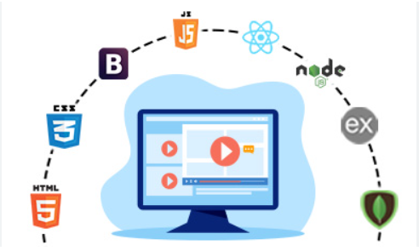
Requirements
Software Requirements
Operating System
Visual Studio Code
Backend Development Requirements
Node.js
Express.js
MongoDB
Frontend Development Requirements
React.js
NPM Packages

Slide 6
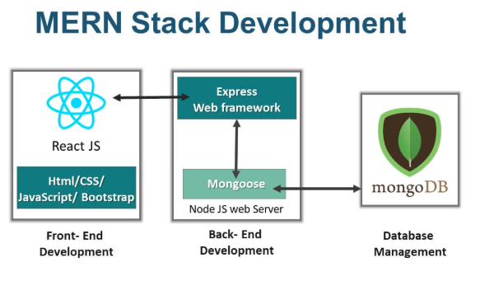
Methodology

Slide 7
Methodology
Design and Development:
Frontend: The user interface is built using React.js, HTML, CSS, and JavaScript to provide a responsive and user-friendly design.
Backend: The server-side logic is managed using Node.js and Express.js to process requests, manage user data, and interact with the database.
Key Features:
User Authentication: Secure login and registration using JWT
Event Management: Users can Login, view current Events, view description, and can book an event.

Slide 8
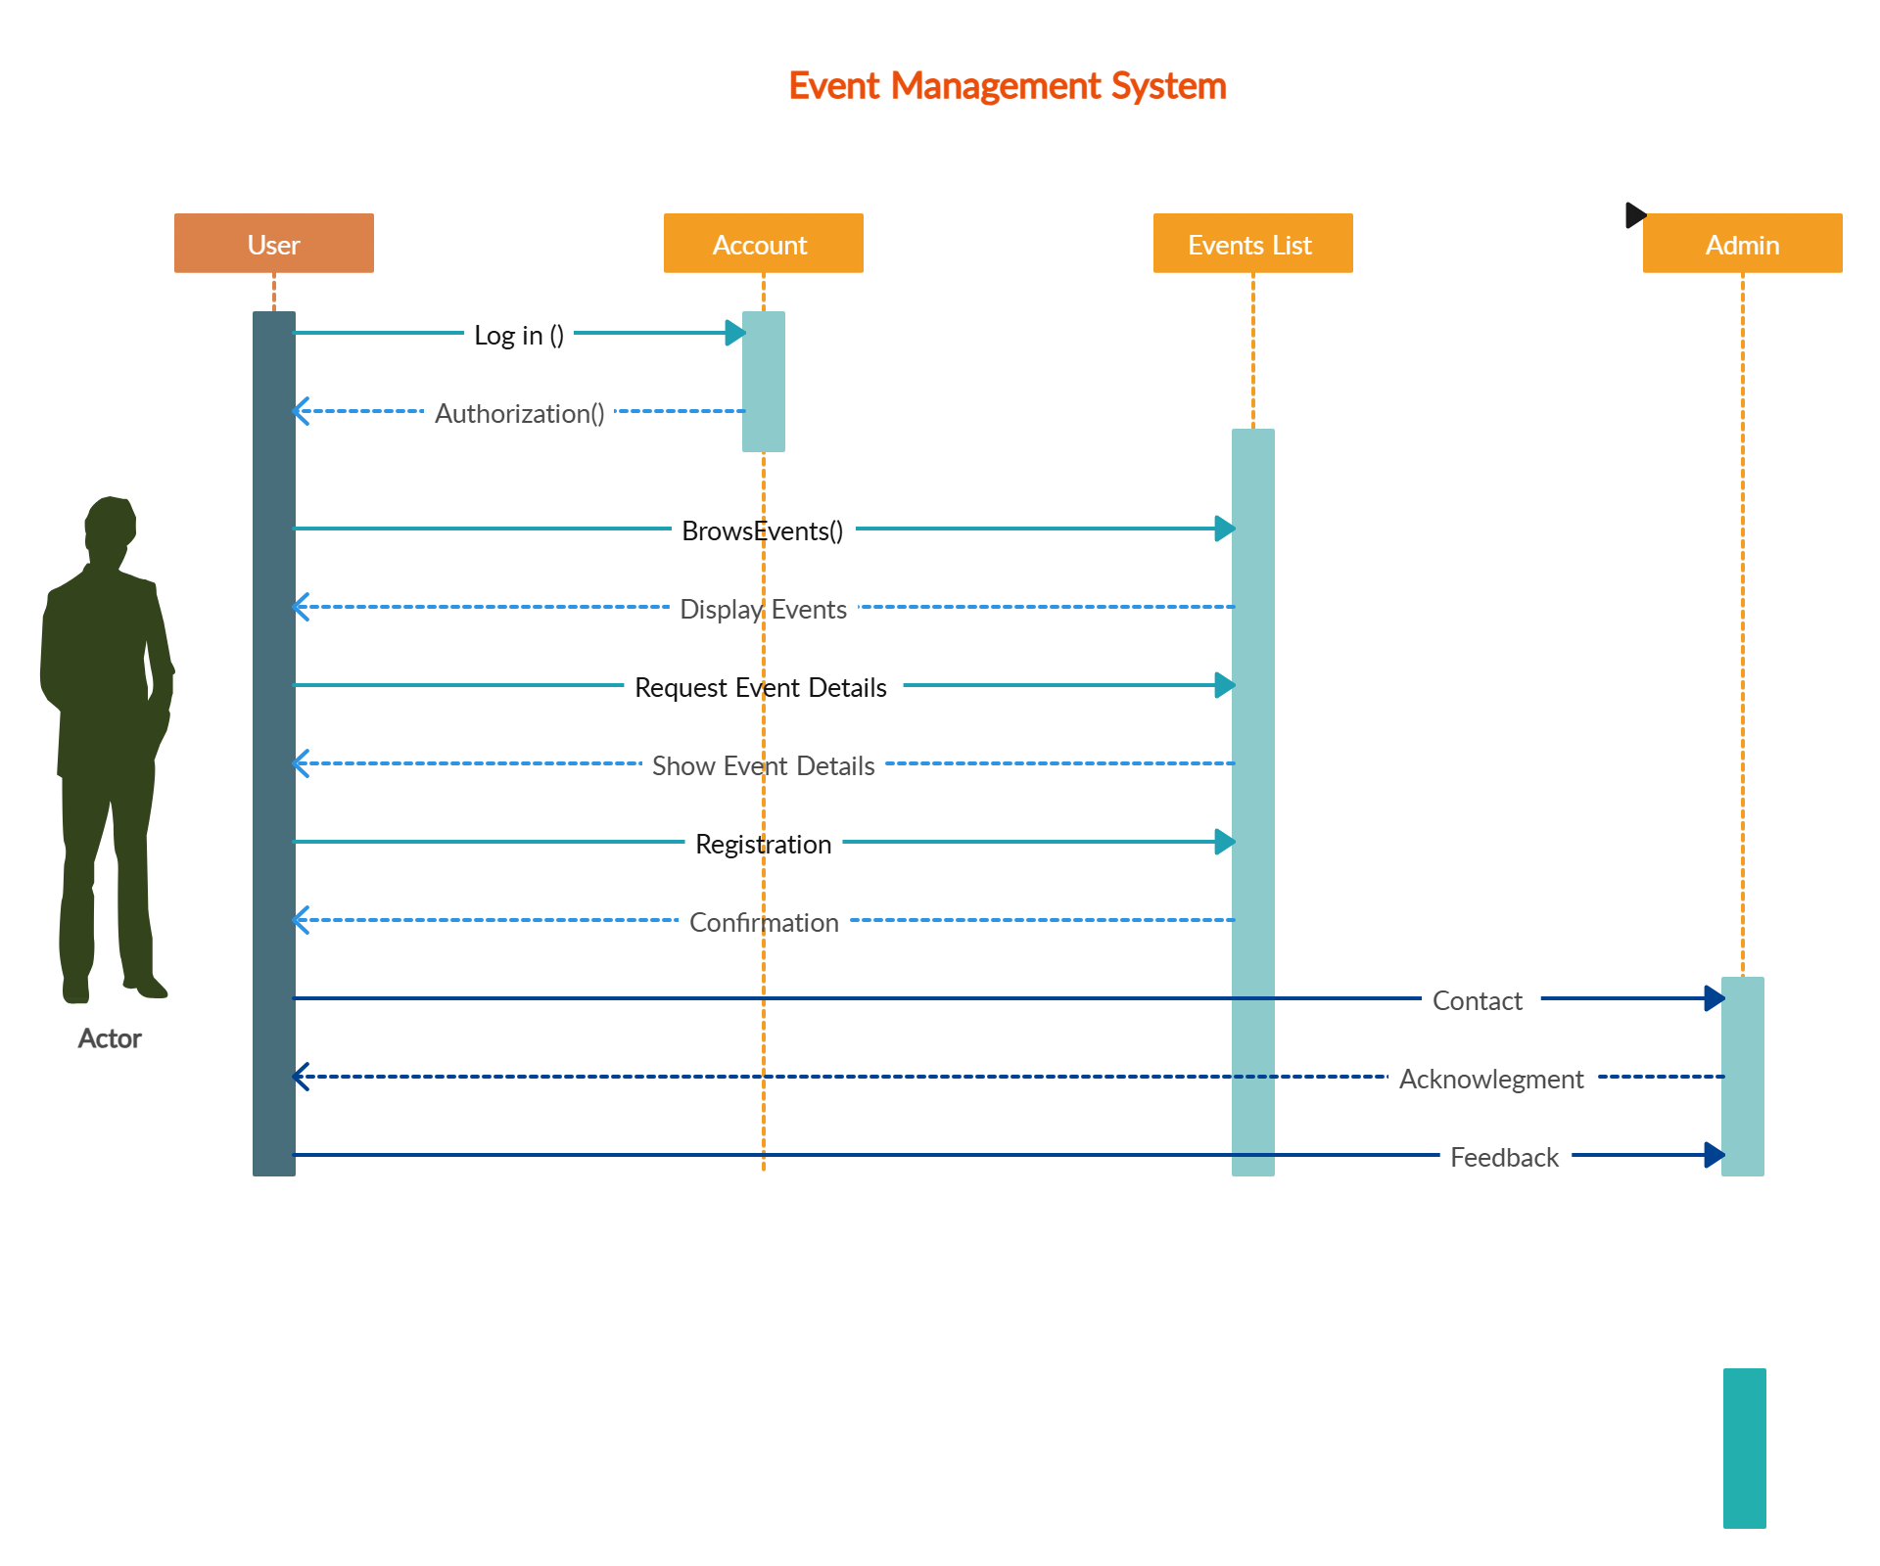
SEQUENCE DIAGRAM:

Slide 9
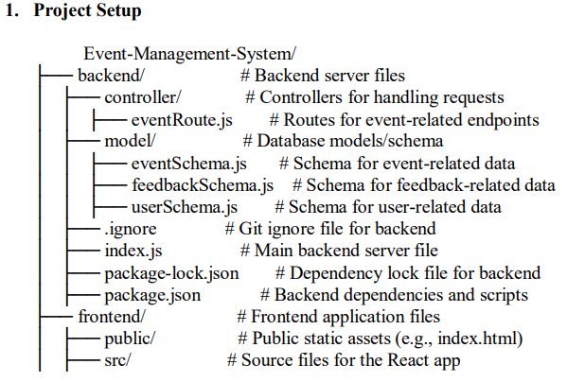
IMPLEMENTATION
The implementation of the Event Management System platform involves several stages, from designing the user interface to developing the backend and integrating them for seamless functionality. Below is an overview of how the platform is implemented

Slide 10
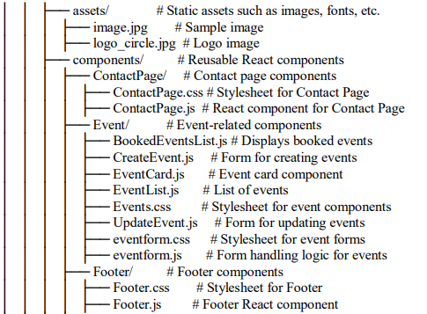
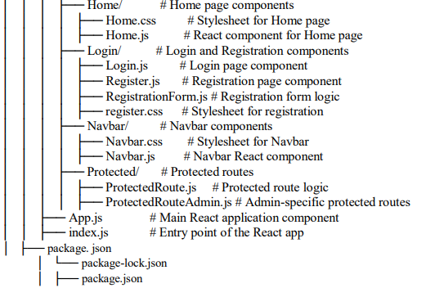

Slide 11
Frontend Implementation
The frontend is developed using React.js to create an interactive and dynamic interface.
Steps:
Initialize React App: Using the command “npx create-react-app”, we set up the project.
Component Setup: Create reusable components
Pages: Set up pages such as Home, Login, Profile, Register, and Templates.
Routing: We use React Router to handle navigation between different pages
Responsive Design: We use Bootstrap or Material-UI to ensure the platform works well on all devices

Slide 12
Backend Implementation
The backend is built using Node.js and Express.js. It ensures that user data is processed and stored securely.
Steps:
Setting up Server: The server is initialized using Express.js to handle HTTP requests.
Database Setup: We use MongoDB (a NoSQL database) to store user profiles and event data. Mongoose is used to interact with the database.
Authentication: We use JWT to manage user sessions and ensure only authenticated users can access their data.
API Routes: The server exposes endpoints for registering, logging in, and managing user data.

Slide 13
Results
Set Up the Backend:
Go to the backend folder: “cd E:\QR-Event-Management-System\backend”
Install backend dependencies: “npm install”
The server will run at: “http://localhost:5000”
Set Up the Frontend:
Go to the frontend folder: “cd E:\QR-Event-Management-System\frontend”
Install frontend dependencies: “npm install”
Start the frontend server: “npm start”
Open your browser and visit “http://localhost:3000” to see the app.

Slide 14
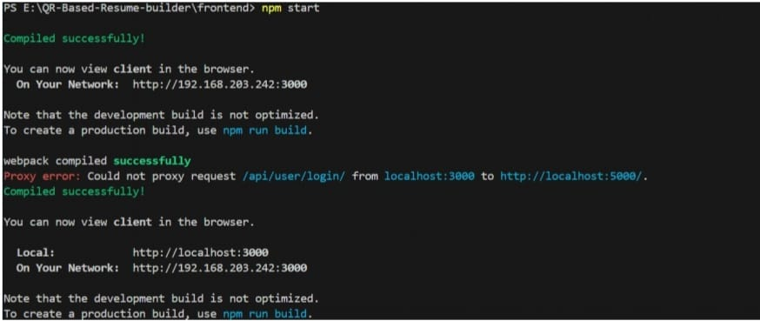
Results
After running both frontend and backend

Slide 15
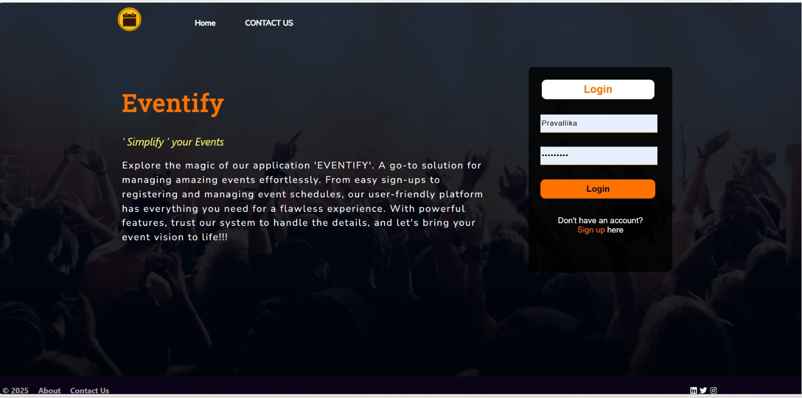
Results
Login page:

Slide 16
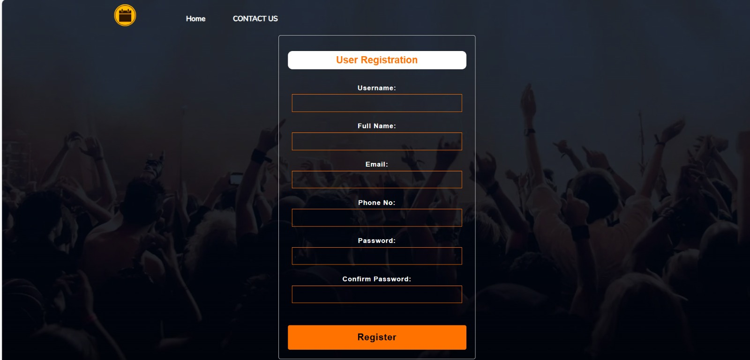
Registration Page:

Slide 17
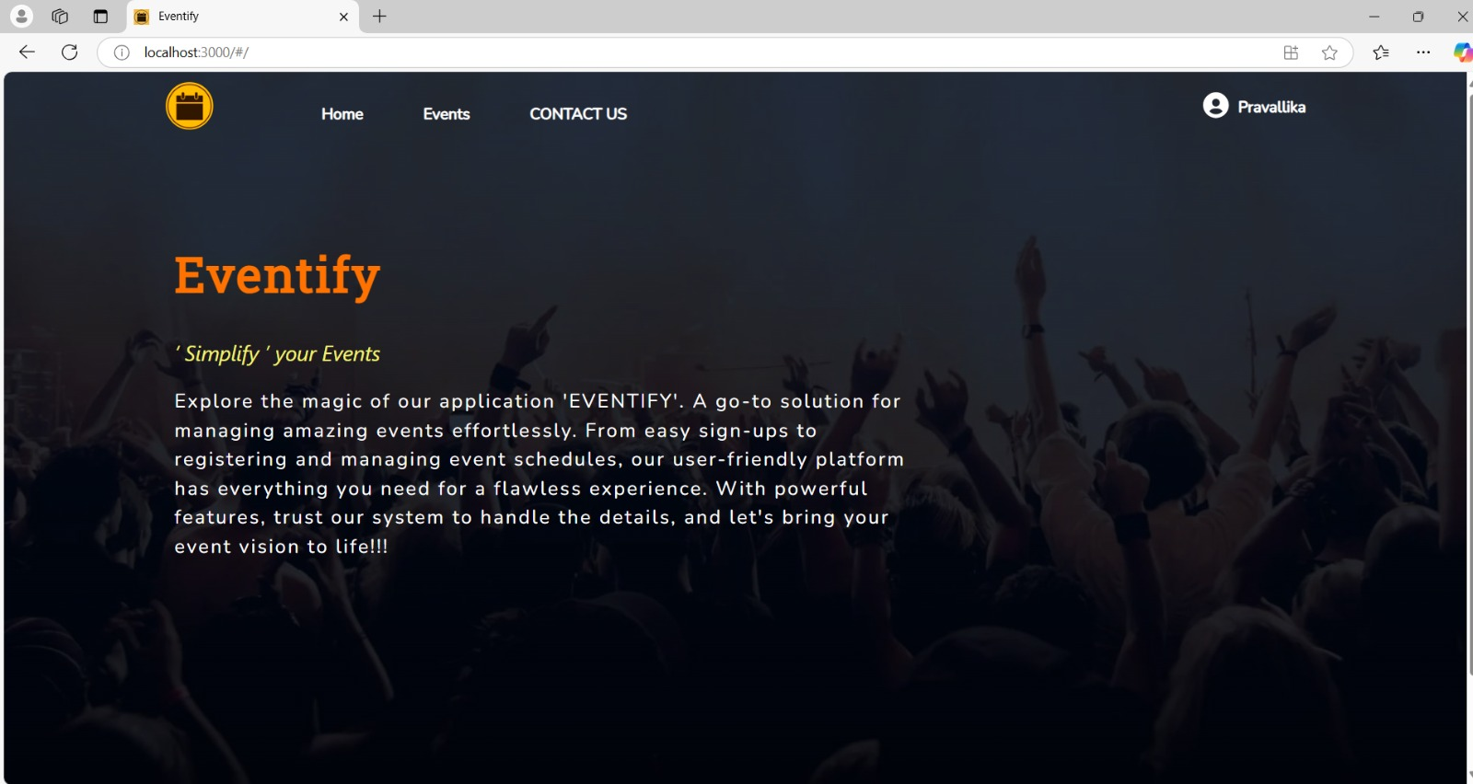
Home Page:

Slide 18
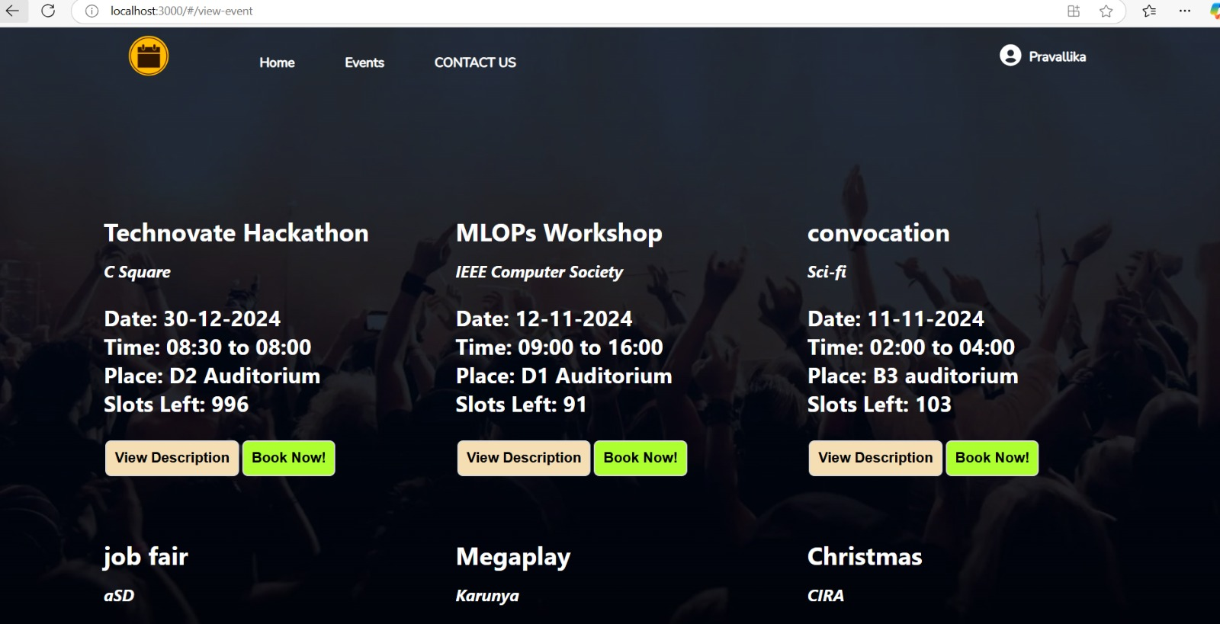
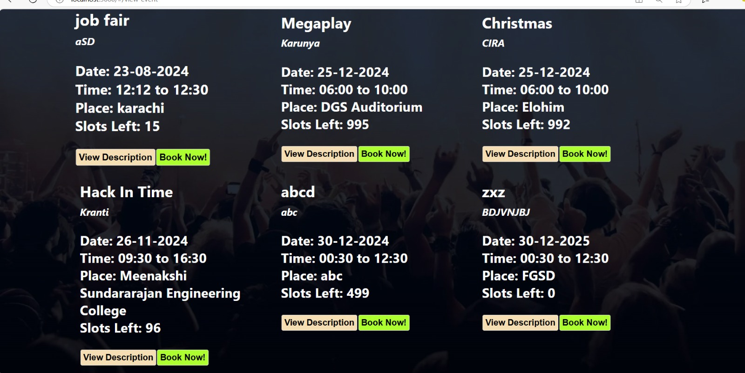
Event Page:

Slide 19
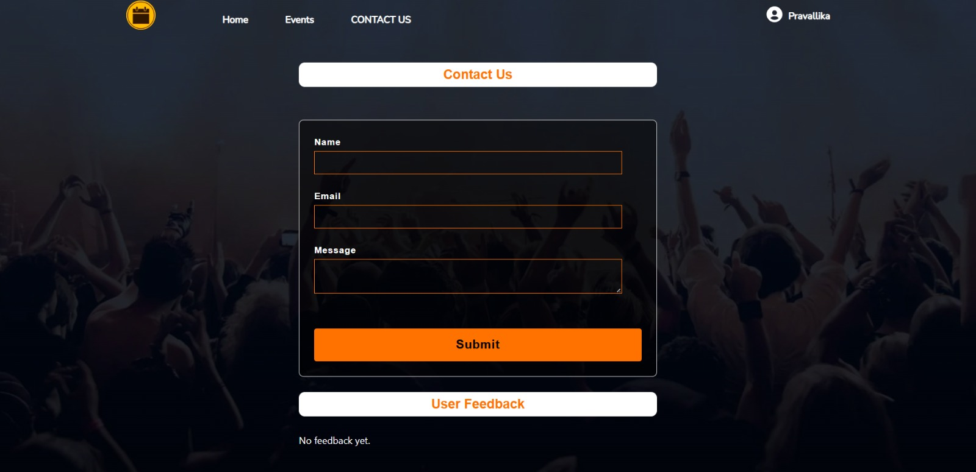
Contact us & Feedback Page:

Slide 20
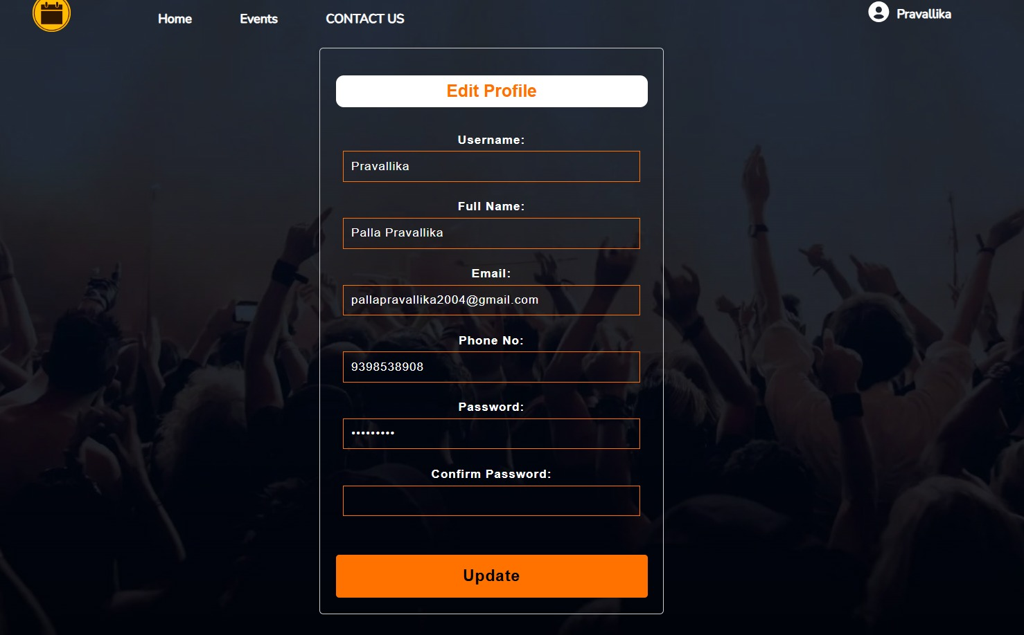
Update Profile

Slide 21
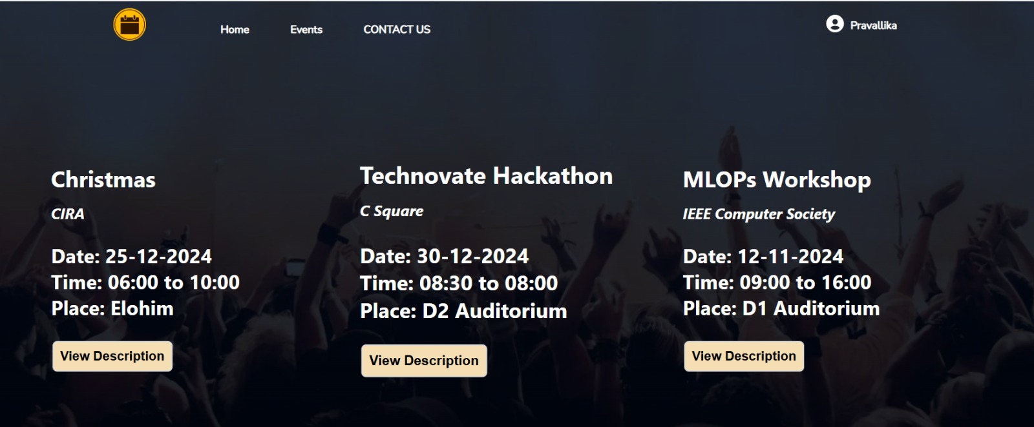
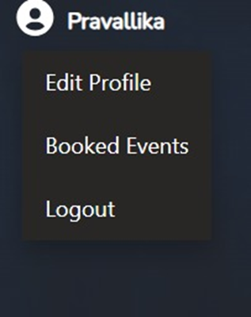
Booked Events

Slide 22
Conclusion:
In conclusion, the Event Management System (EMS) built with the MERN stack offers a scalable,
efficient, and interactive platform for managing events. By combining MongoDB's flexibility, Node.js's real-time capabilities, Express.js's robust routing, and React.js's dynamic user interfaces, the EMS streamlines tasks like registration, ticketing, scheduling, and communication. It serves as a comprehensive tool that enhances event execution and improves attendee experience, from initial registration to post-event analysis. Suitable for various events, including corporate gatherings, festivals, and workshops, the MERN-based EMS highlights the power of modern web technologies. It simplifies event management, boosts operational efficiency, and provides scalability and maintainability for future growth and feature enhancements.

Slide 23
Thank You!

